Slide 1
Corporate Social Responsibility
Mrs. M. Durgadevi., M.Com., M.Phil., SET., NET.
Assistant Professor
Department of Commerce
Mahalakshmi Art & Science College Avadi.

Slide 2

Companies commitments
Involves business going beyond profit making to acting contribute to well being of society
Environment engage with stakeholders
Including employees customers communities and government

Slide 3
Levels
Economic responsibility
(Profitability and Sustainability)

Slide 4

Legal responsibility (Compliance with National and International Laws and Regulations)

Slide 5

Ethical responsibility
(Ethical decision making and behavior that respects stakeholders interest)

Slide 6
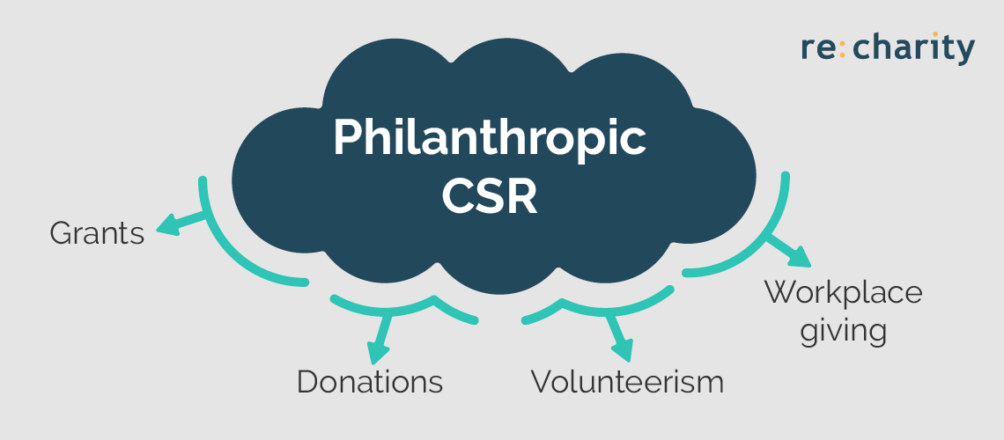
Philanthropic responsibility
(Giving back to Society through charitable actions)

Slide 7

Environment Responsibility
(Keep Environment Clean)

Slide 8

Approaches
Strategies Approach
Stakeholder Approach
Sustainable Development
Economic Approach
Statutory Approach
Ethical Approach

Slide 9

Accountability
Transparency
Ethical Behavior
Respect for Stakeholder Interests
Sustainable Development
Compliance with Laws and International Laws
Social Inclusion
Continuous Improvements

Slide 10


Slide 11

Transparency

Slide 12

Ethical Behavior

Slide 13
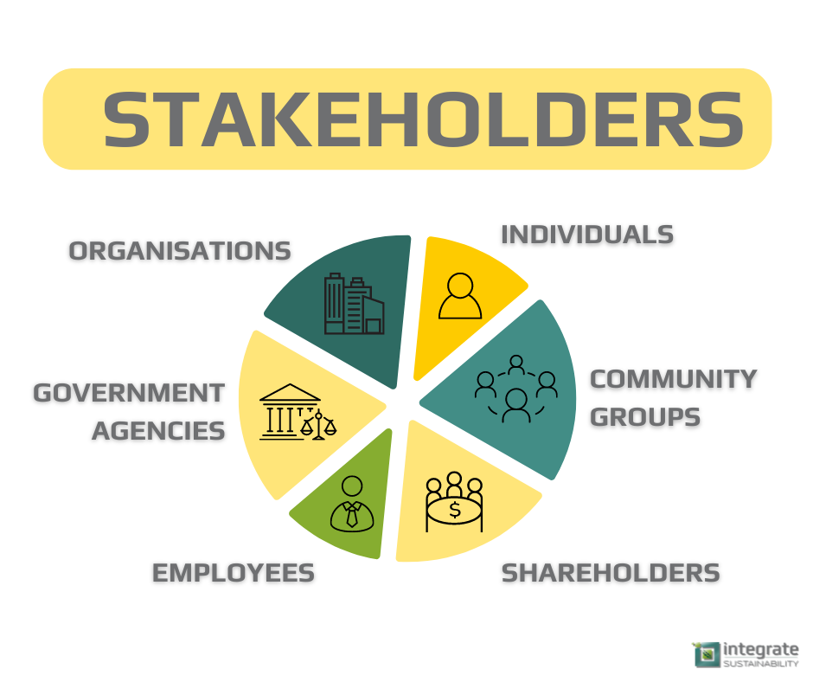
Respect for Stakeholder Interests

Slide 14

Sustainable Development

Slide 15

Compliance with Laws and International Laws

Slide 16

Social Inclusion

Slide 17

Continuous Improvements

Slide 18
Indian Models
Community Development Model (Focus on development of communities)
Statutory Compliance Model (Section 135 of Indian Companies Act 2013, Spend at least two percent of their average profit on CSR activities)
Partnership Model (Collaboration between NGO and other stakeholders)
Inclusive Business Model (Designed model to underprivileged sections of societies)
Sustainable Development Model ( Long term process)
Employee Volunteerism (Encourages employees to engaged in volunteer work)

Slide 19
Legal
Profit Dimension
Moral Obligation
Global Issues
Dimensions
Environmental Protection
Collaboration
Social Welfare
Protecting Human Dignity
Voluntary Contribution

Slide 20
CORPORATE SOCIAL REPORTING
Practice of company disclosing its social environmental and economical performance of stakeholders.

Slide 21
Objectives of social reporting
Accountability
Measuring and communicating impact
Enhancing stakeholder engagement
Compliance with regulatory requirements
Enhancing corporate reputation and brand values
Risk management
Supporting decision making and strategy development
Enhancing employee engagement and retention

Slide 22


